Slide 1


Maths Open Morning
Salcombe C of E Primary School

Slide 2
Aims
To share the expectations of a mastery curriculum
To share some of the activities that we do in school
To provide ideas on how you can support your child at home

Slide 3
A child that is good at maths:
Takes risks
Asks questions and explores alternative solutions without fear of being wrong
Enjoys exploring and applying mathematical concepts to understand and solve problems
Explains their thinking and presenting their solutions to others in a variety of ways
Reasons logically and creatively through discussion of mathematical ideas and concepts
Becomes a fluent, flexible thinker able to see and make connections

Slide 4
Maths curriculum 2014
The national curriculum for mathematics aims to ensure that all pupils:
Become fluent in the fundamentals of maths. This means that they develop a good understanding of our number system. They need to know key number facts and be able to recall them rapidly so that they can use this knowledge rapidly and accurately.

Slide 5
Maths curriculum 2014
The national curriculum for mathematics aims to ensure that all pupils:
Reason mathematically and explain their thinking using mathematical language as they work on different areas of maths. They need to be able to ask mathematical questions and work out ways to answer them. Children also need to be able to look for patterns and use them to make predictions or generalisations. Being able to justify their ideas is a vital skill.

Slide 6
Maths curriculum 2014
The national curriculum for mathematics aims to ensure that all pupils:
Can solve problems by applying their understanding of maths to different types of problems so that they are able to break them down into a series of simpler steps. When children find a problem challenging they are encouraged to persevere and keep trying different ideas as they seek a solution. Understanding is the key.

Slide 7
Expectations
Knowledge of all compact methods – Year 4
Fractions introduced in Year 1. By Year 6 children are expected to be able to calculate with fractions
Roman numerals – up to 1000 in Years 3 and 4
Stronger emphasis on algebra and find unknowns in an equation
By the time children are at the end of Year 4 they should know their times tables to 12 x 12

Slide 8
Testing
Key Stage 1
Paper 1 – Arithmetic (25 Qs in approx. 20 mins)
Paper 2 - Reasoning
Year 4 Times table test 2020
All completed online
The children will have 6 seconds to answer each question

Slide 9
Testing
Key Stage 2
Paper 1 – Arithmetic (36 questions in 30 mins)
Paper 2 – Reasoning (40 mins)
Paper 3 – Reasoning

Slide 10
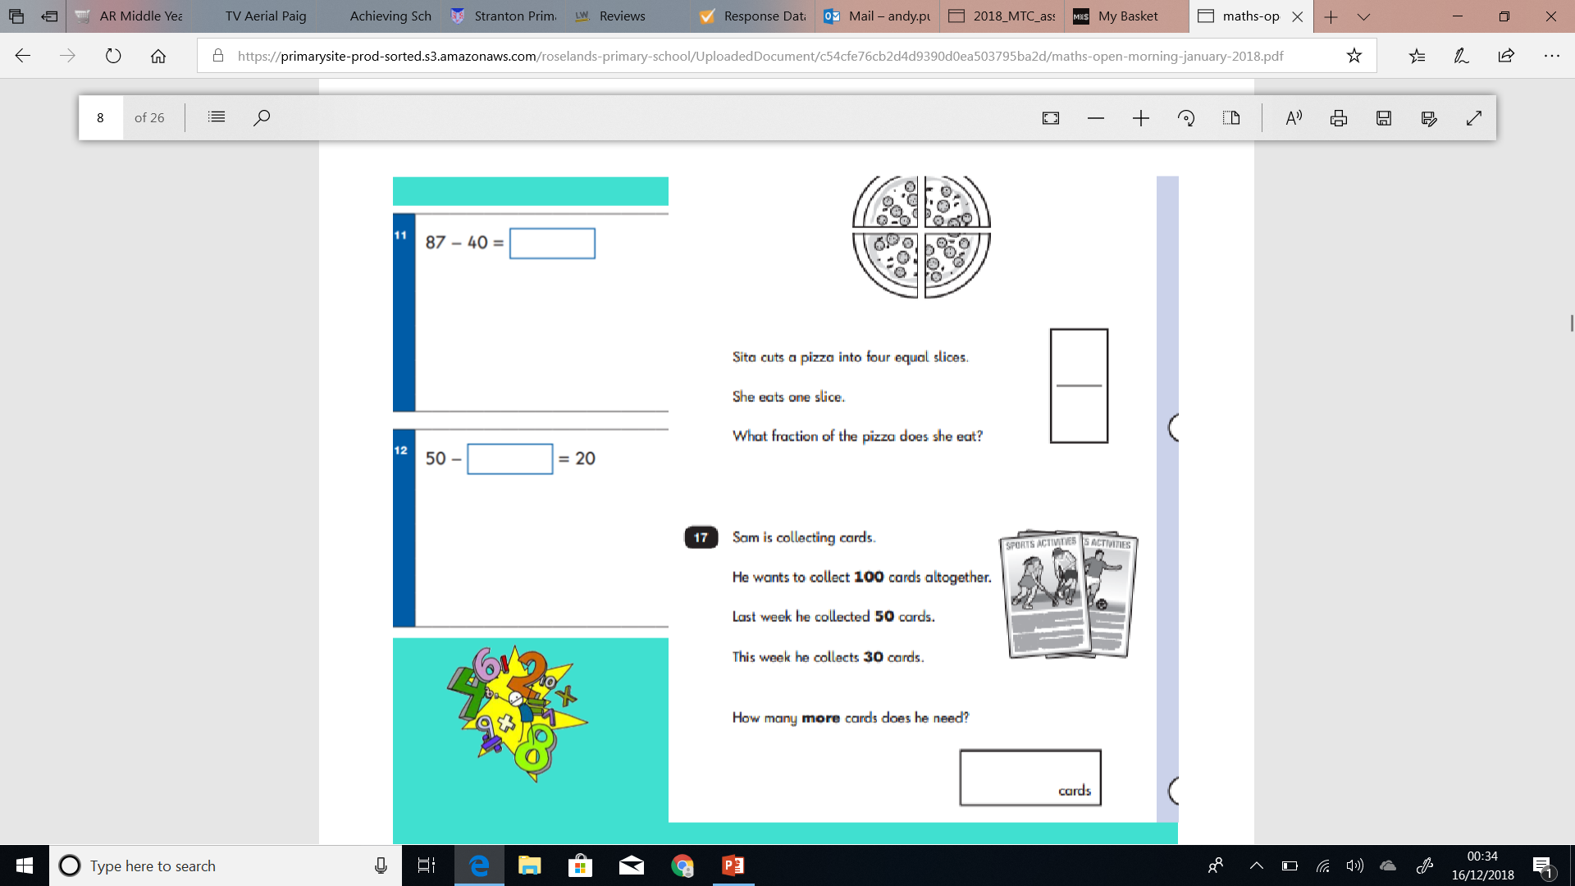

Slide 11
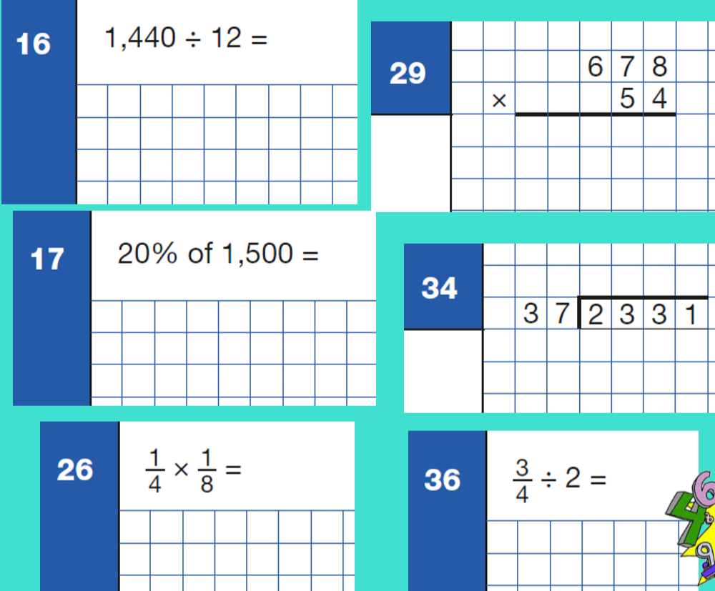

Slide 12
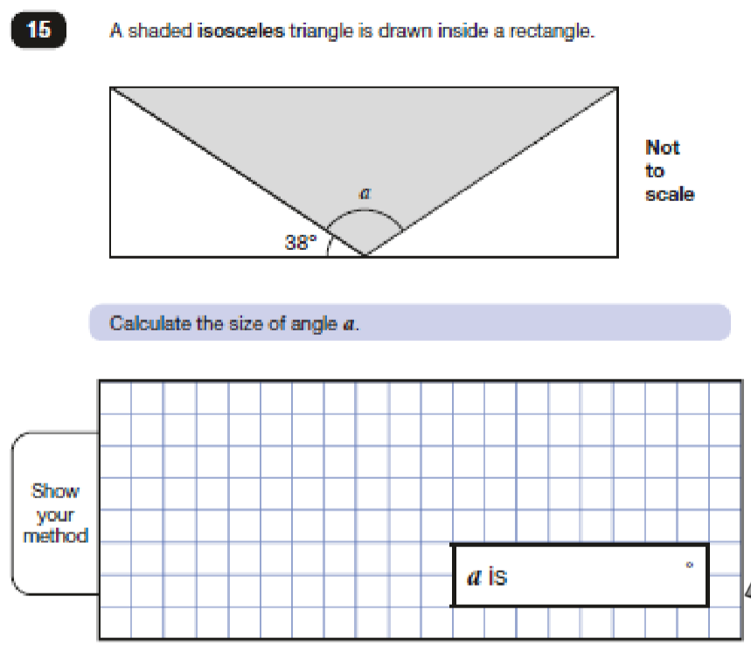

Slide 13
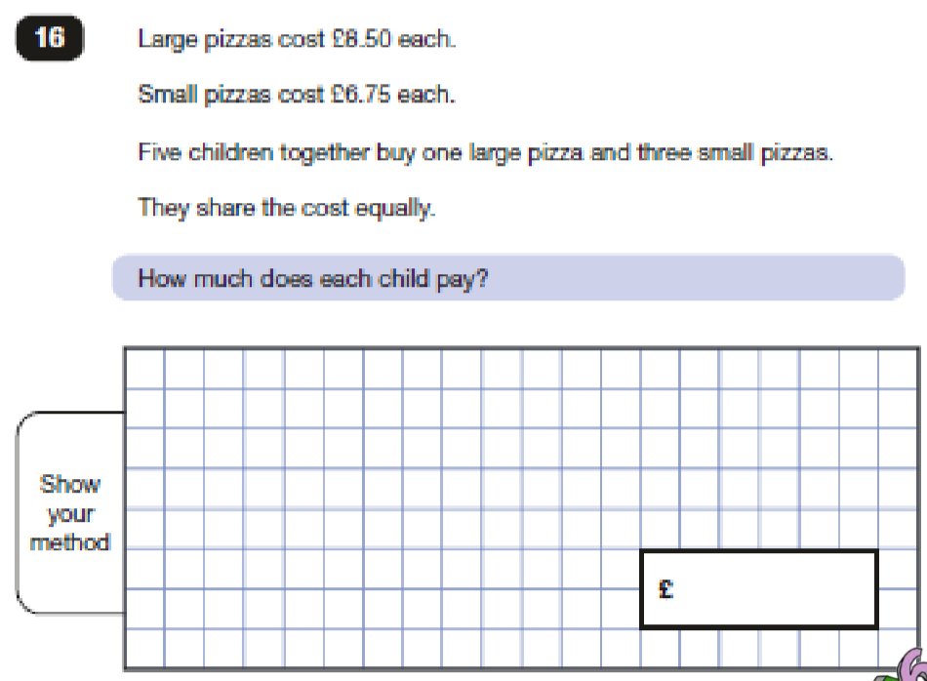

Slide 14
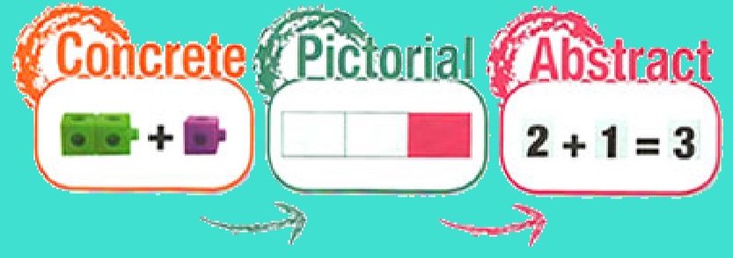

Slide 15
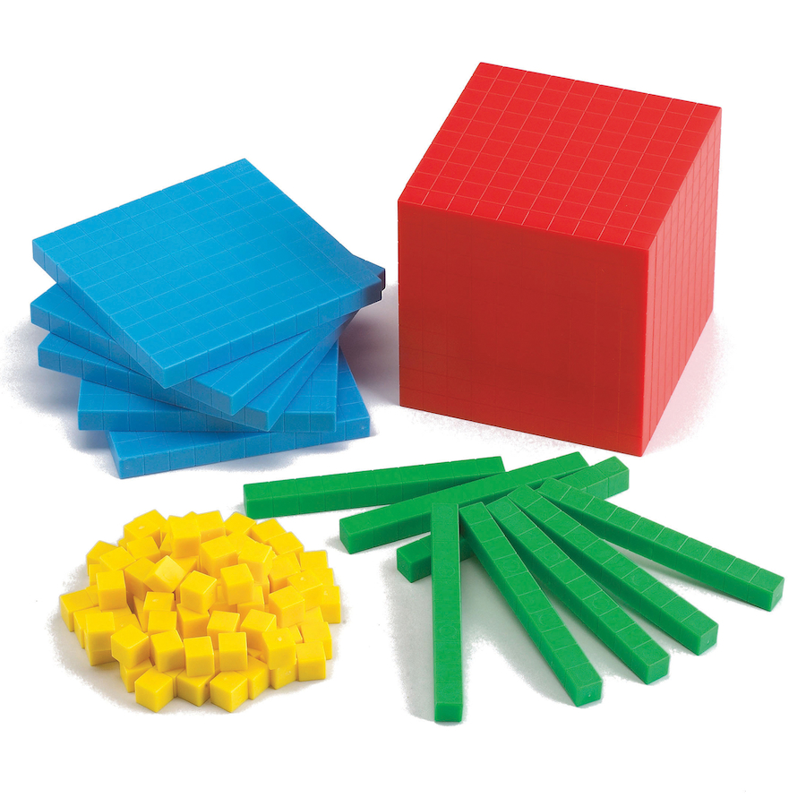
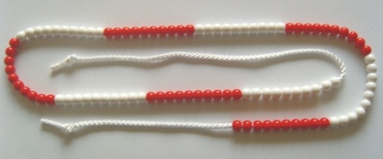
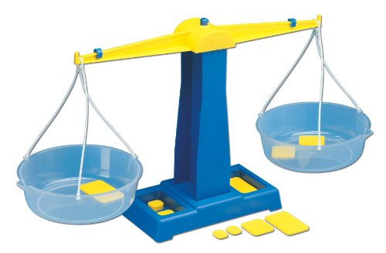
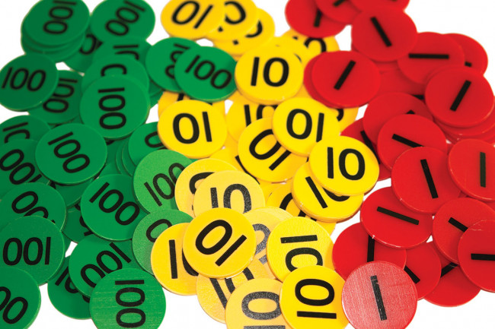
Concrete Representation
This is when ‘hands on’ resources are used to represent different concepts in maths.

Slide 16
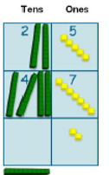
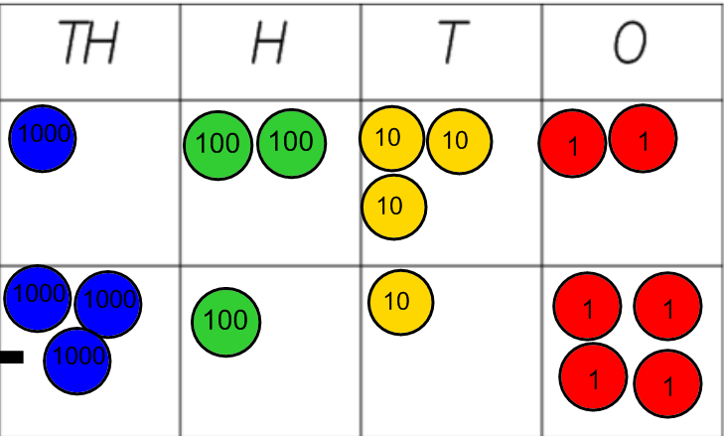
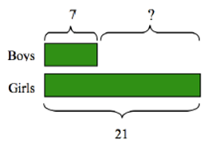
Pictorial Representation
Using representations, such as diagrams or a picture of a problem.

Slide 17
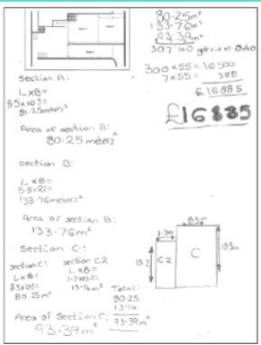

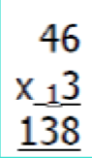
Abstract Representation
The symbolic stage where a child is now capable of representing problems by using mathematical notation 12 – 7 = 5.

Slide 18
Showing MASTERY
Describe an idea or concept in his or her own words
Represent it in a variety of different ways e.g. using
concrete materials, pictures or symbols
Explain it to someone else
Make up his or her own examples (and non examples) of the idea
See connections between it and other ideas
Recognise the maths in different context and situations

Slide 19
Helping at home
Cooking
Look at numbers in the environment e.g number plates, book pages, sleeps until Christmas, shopping.
Money
Comparing heights
Birthdays, moths of the year, days of the week

Slide 20
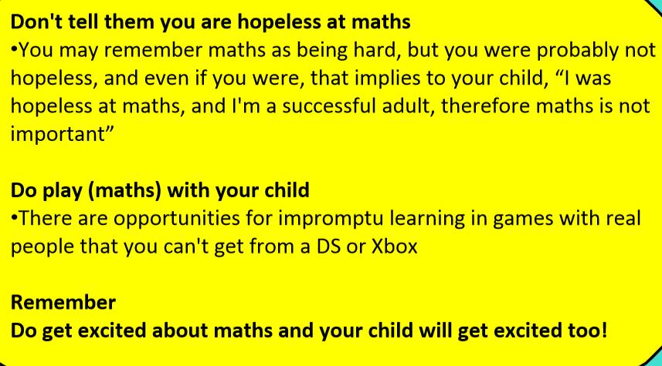
Helping at home

